Slide 1
Probability Distributions

Slide 2
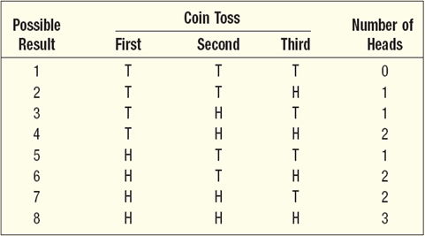
What is a Probability Distribution?
Experiment: Toss a coin three times.
Observe the number of heads. The possible
results are: zero heads, one head, two heads, and three heads.
What is the probability distribution for the number of heads?

Slide 3
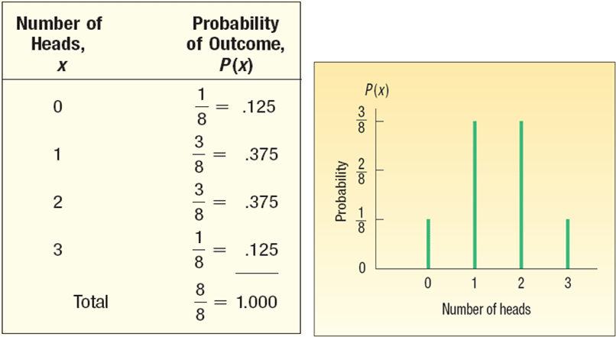
Probability Distribution of Number of Heads Observed in 3 Tosses of a Coin

Slide 4
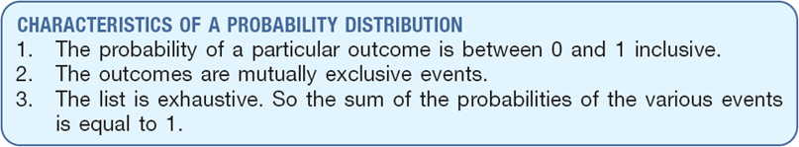
Characteristics of a Probability Distribution

Slide 5
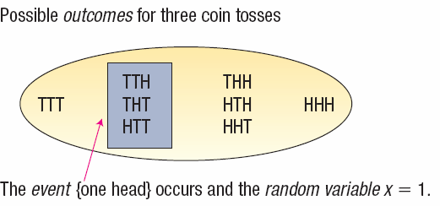
Random Variables
Random variable - a quantity resulting from an experiment that, by chance, can assume different values.

Slide 6
Types of Random Variables
Discrete Random Variable can assume only certain clearly separated values. It is usually the result of counting something
Continuous Random Variable can assume an infinite number of values within a given range. It is usually the result of some type of measurement

Slide 7
Discrete Random Variables - Examples
●
●
●
●
The number of students in a class. The number of children in a family.
The number of cars entering a carwash in a hour.
Number of home mortgages approved by Coastal Federal Bank last week.

Slide 8
Continuous Random Variables - Examples
The distance students travel to class.
The time it takes an executive to drive to work.
The length of an afternoon nap.
The length of time of a particular phone call.
Typically, monetary amounts

Slide 9
Features of a Discrete Distribution
The main features of a discrete probability distribution are:
The sum of the probabilities of the various outcomes is 1.00.
The probability of a particular outcome is between 0 and 1.00.
The outcomes are mutually exclusive.

Slide 10
The Mean of a Probability Distribution
MEAN
The mean is a typical value used to represent the central location of a probability distribution.
The mean of a probability distribution is also referred to as its expected value.

Slide 11
The Variance, and Standard Deviation of a Probability Distribution
Variance and Standard Deviation
Measures the amount of spread in a distribution
The computational steps are:
Subtract the mean from each value, and square this difference.
Multiply each squared difference by its probability.
Sum the resulting products to arrive at the variance.
The standard deviation is found by taking the positive square root of the variance.

Slide 12

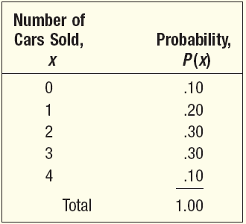
Mean, Variance, and Standard
Deviation of a Probability Distribution - Example
John Ragsdale sells new cars for Pelican Ford. John usually sells the largest number of cars on Saturday. He has developed the following probability distribution for the number of cars he expects to sell on a particular Saturday.

Slide 13
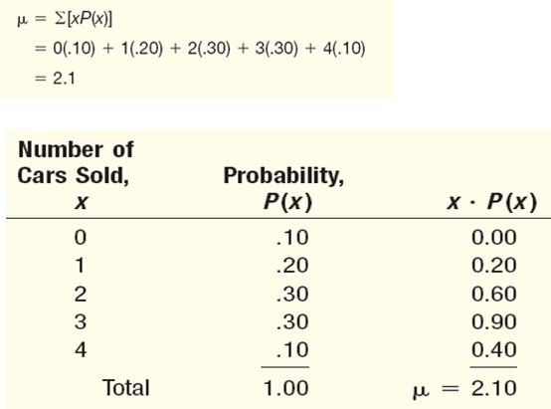
Mean of a Probability Distribution - Example

Slide 14
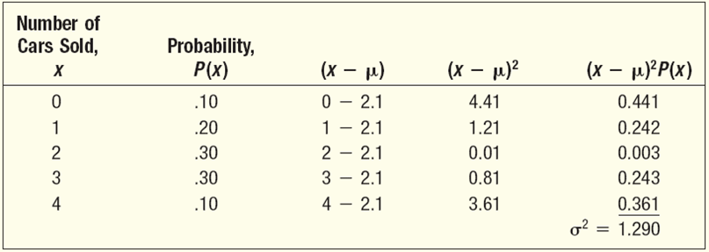
Variance and Standard
Deviation of a Probability Distribution - Example

Slide 15
Binomial Probability Distribution
There are only two possible outcomes on a particular trial of an experiment. (Yes or No, Success or Failure, etc.)
The outcomes are mutually exclusive,
The random variable is the sum of a given outcome over the trials
Each trial is independent of any other trial
Probability of outcome does not vary from trial to trial

Slide 16
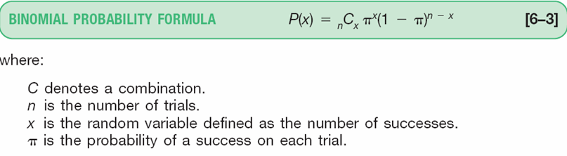
Binomial Probability Formula

Slide 17
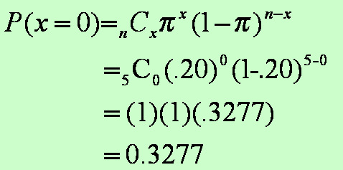
Binomial Probability - Example
There are five flights daily from Pittsburgh via US Airways into the Bradford, Pennsylvania, Regional Airport.
Suppose the
probability that any flight arrives late is . 20.
What is the probability that none of the flights are late today?

Slide 18
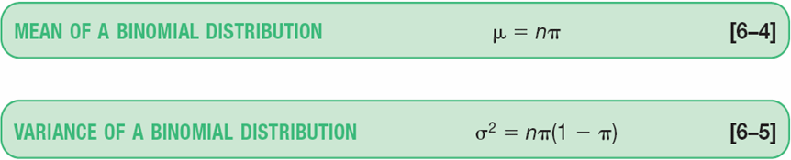
Binomial Dist. – Mean and Variance

Slide 19
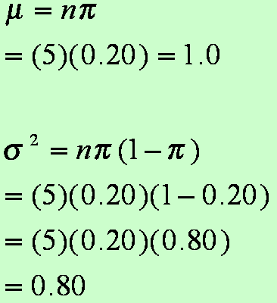
Binomial Dist. – Mean and Variance: Example
For the example regarding the number of late flights, recall that π =.20 and n = 5.
What is the average number of late flights?
What is the variance of the number of late flights?

Slide 20
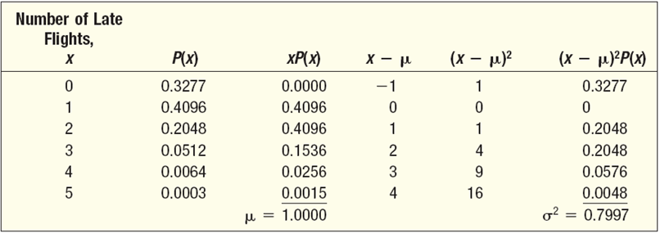
Binomial Dist. – Mean and Variance: Another Solution

Slide 21
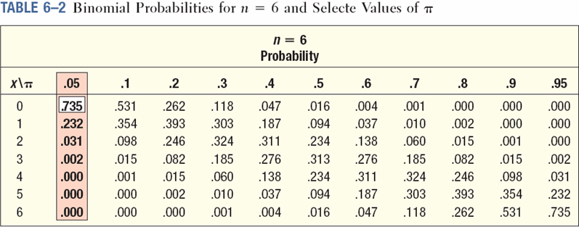
Binomial Distribution - Table
Five percent of the worm gears produced by an automatic, high- speed Carter-Bell milling machine are defective. What is the probability that out of six gears selected at random none will be defective? Exactly one? Exactly two? Exactly three? Exactly four? Exactly five? Exactly six out of six?

Slide 22
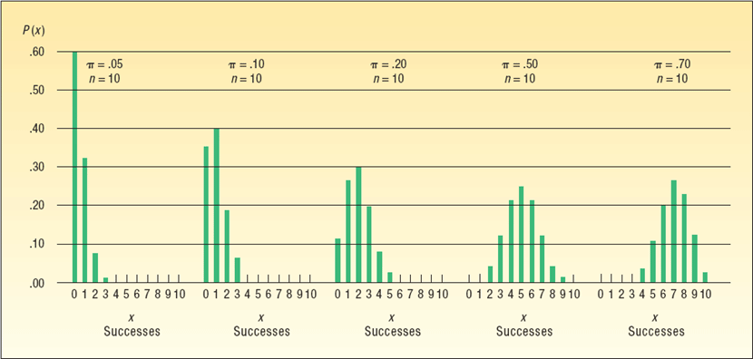
Binomial – Shapes for Varying π
(n constant)

Slide 23
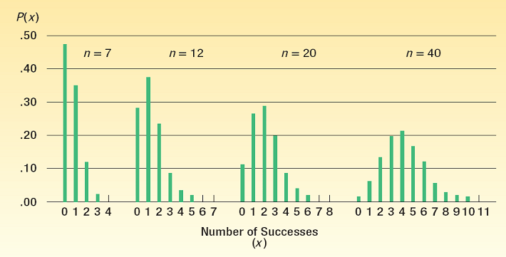
Binomial – Shapes for Varying n
(π constant)

Slide 24
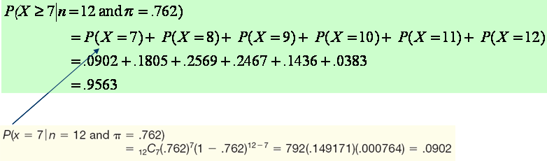
Cumulative Binomial Probability Distributions
A study in June 2003 by the Illinois Department of Transportation concluded that 76.2 percent of front seat occupants used seat belts. A sample of 12 vehicles is selected. What is the probability the front seat occupants in at least 7 of the 12 vehicles are wearing seat belts?

Slide 25
Binomial Probabilities from Excel
Use function BINOMDIST(S,N,Prob,Logical)
S is the number of successes
N is the number of trials
Prob is the probability of success
Logical =1 indicates cumulative probability and Logical = 0 indicates probability of exactly S successes in N trials.

Slide 26
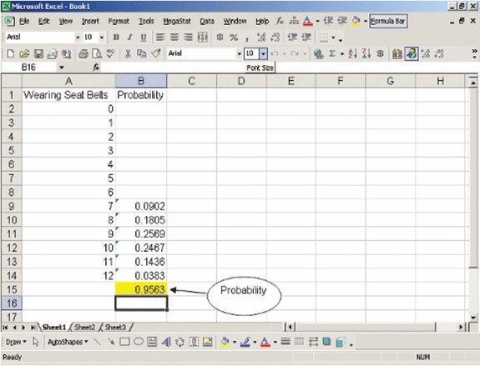
Cumulative Binomial Probability Distributions - Excel

Slide 27
Hypergeometric Distribution
The hypergeometric distribution has the following characteristics:
There are only 2 possible outcomes.
The probability of a success is not the same on each trial. (Sampling without replacement)
It results from a count of the number of successes in a fixed number of trials.

Slide 28
Hypergeometric Distribution
Use the hypergeometric distribution to find the probability of a specified number of successes or failures if:
the sample is selected from a finite population without replacement
the size of the sample n is greater than 5% of the size of the population N (i.e. n/N ≥ .05)

Slide 29
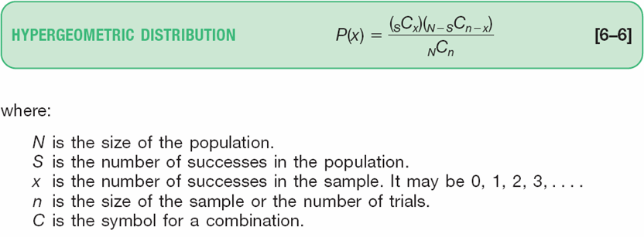
Hypergeometric Distribution

Slide 30

Hypergeometric Distribution - Example
PlayTime Toys, Inc., employs 50 people in the Assembly Department. Forty of the employees belong to a union and ten do not. Five employees are selected at random to form a committee to meet with management regarding shift starting times. What is the probability that four of the five selected for the committee belong to a union?

Slide 31
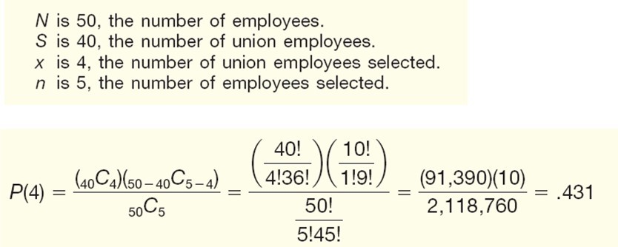
Hypergeometric Distribution - Example

Slide 32
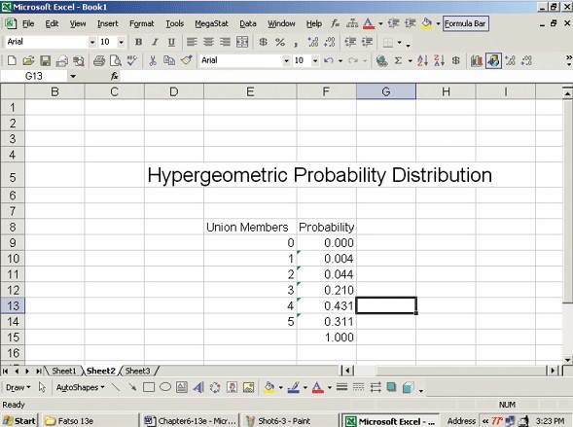
Hypergeometric Distribution - Excel

Slide 33
Hypergeometric Probabilities- Excel
Use function HYPERGEOMDIST(x,n,S,N)
x is the number of successes
n is sample size or number of trials
S is the number of successes in the population
N is the size of the population.

Slide 34
Poisson Probability Distribution
The Poisson probability distribution describes the number of times some event occurs during a specified interval. The interval may be time, distance, area, or volume.
Assumptions of the Poisson Distribution
The probability is proportional to the length of the interval.
The intervals are independent.

Slide 35
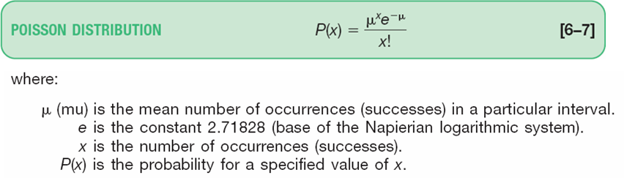
Poisson Probability Distribution
The Poisson distribution can be described mathematically using the formula:

Slide 36
Poisson Probability Distribution
The mean number of successes T can be determined in binomial situations by nπ, where n is the number of trials and π the probability of a success.
The variance of the Poisson distribution is also equal to n π.

Slide 37
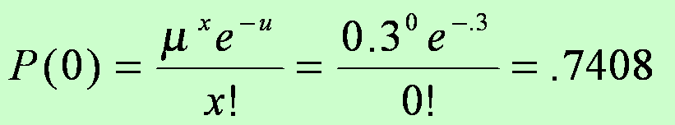
Poisson Probability Distribution - Example
Assume baggage is rarely lost by Northwest Airlines.
Suppose a random sample of 1,000 flights shows a total of 300 bags were lost. Thus, the arithmetic mean number of lost bags per flight is 0.3 (300/1,000). If the number of lost bags per flight follows a Poisson distribution with u = 0.3, find the probability of not losing any bags.

Slide 38
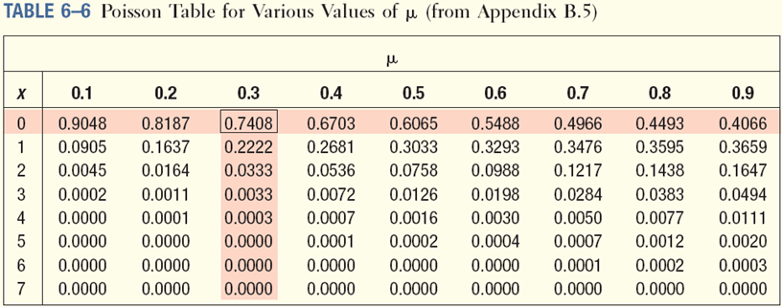
Poisson Probability Distribution - Table
Assume baggage is rarely lost by Northwest Airlines. Suppose a random sample of 1,000 flights shows a total of 300 bags were lost. Thus, the arithmetic mean number of lost bags per flight is 0.3 (300/1,000). If the number of lost bags per flight follows a Poisson distribution with mean
= 0.3, find the probability of not losing any bags

Slide 39
Poison Probabilities from Excel
Use function POISSON(x,μ,Logical)
X is the number of success (occurrences)
μ mean number of successes (occurrences)
Logical =1 indicates cumulative probability and Logical = 0 indicates probability of exactly S successes in N trials.

Slide 40
Poission Vs Binomial
If your question has an average probability of an event happening per unit (i.e. per unit of time, cycle, event) and you want to find probability of a certain number of events happening in a period of time (or number of events), then use the Poisson Distribution.
If you are given an exact probability and you want to find the probability of the event happening a certain number out times out of x (i.e. 10 times out of 100, or 99 times out of 1000), use the Binomial Distribution formula.

